Slide 1

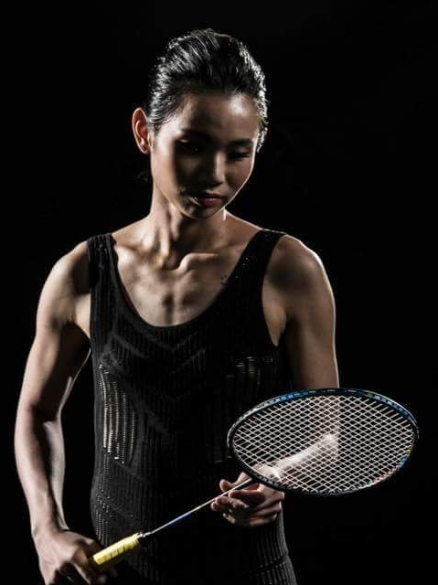






World #1
Women’s Singles
Women’s Singles
TAI Tzu Ying
55
Rally Domination (%)
21
matches consecutively won
at most
22
Fastest match (mins)
79
Longest match (mins)
7-0
Best Head-to-Head
(bt. Busanan ONGBAMRUNGPHAN)
3 Last Top Achievements
All England 2020
Denmark Open 2019
Singapore Open 2019
Calculations based only on matches from BWF World Tour ≥ S300 Level, starting from 2018 to All England 2020
Match Sources: bwfbadminton.com Rally Domination: total points won / total points, from all of matches
Badminton Central

Slide 2






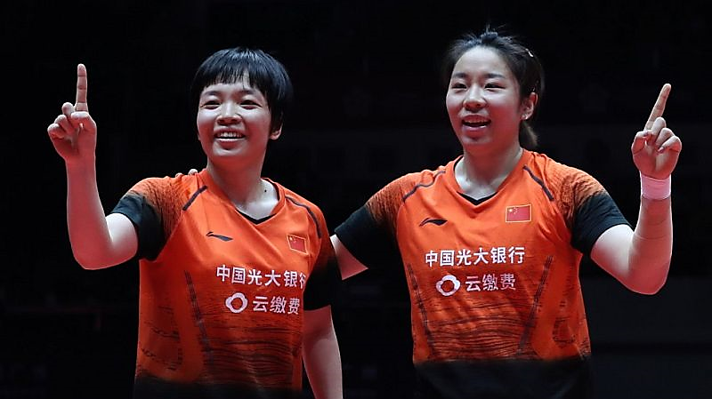

World #1
Women’s Doubles
CHEN Qing Chen/JIA Yi Fan
54
23
Rally Domination (%)
Fastest match (mins)
7
94
matches consecutively won
at most
Longest match (mins)
4-0
3 Last Top Achievements
Best Head-to-Head
(bt. DU/LI)
Thailand Masters 2020
BWF World Tour Final 2019
Hong Kong China Open 2019
Calculations based only on matches from BWF World Tour ≥ S300 Level, starting from 2018 to All England 2020
Match Sources: bwfbadminton.com Rally Domination: total points won / total points, from all of matches
BWF

Slide 3





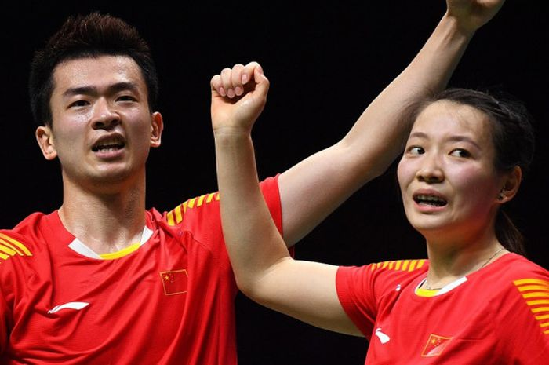

World #1
Mixed Doubles
ZHENG Si Wei/HUANG Ya Qiong
57
18
Rally Domination (%)
Fastest match (mins)
19
69
matches consecutively won
at most
Longest match (mins)
11-2
3 Last Top Achievements
Best Head-to-Head
(bt. WANG/HUANG)
Indonesia Masters 2020
Malaysia Masters 2020
BWF World Tour
Final 2019
Calculations based only on matches from BWF World Tour ≥ S300 Level, starting from 2018 to All England 2020
Match Sources: bwfbadminton.com Rally Domination: total points won / total points, from all of matches
Johannes Eiselle
(AFP Photo)

Slide 4




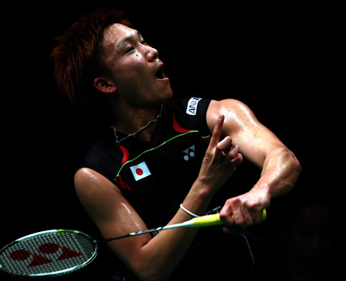

World #1
Men’s Singles
Kento MOMOTA
56
28
Rally Domination (%)
Fastest match (mins)
17
97
matches consecutively won
at most
Longest match (mins)
7-0
Best Head-to-Head
(bt. Viktor AXELSEN)
3 Last Top Achievements
Malaysia Masters 2020
BWF World Tour Final 2019
Fuzhou China Open 2019
Image: Bola.com
Calculations based only on matches from BWF World Tour ≥ S300 Level, starting from 2018 to All England 2020
Match Sources: bwfbadminton.com Rally Domination: total points won / total points, from all of matches
Zimbio

Slide 5

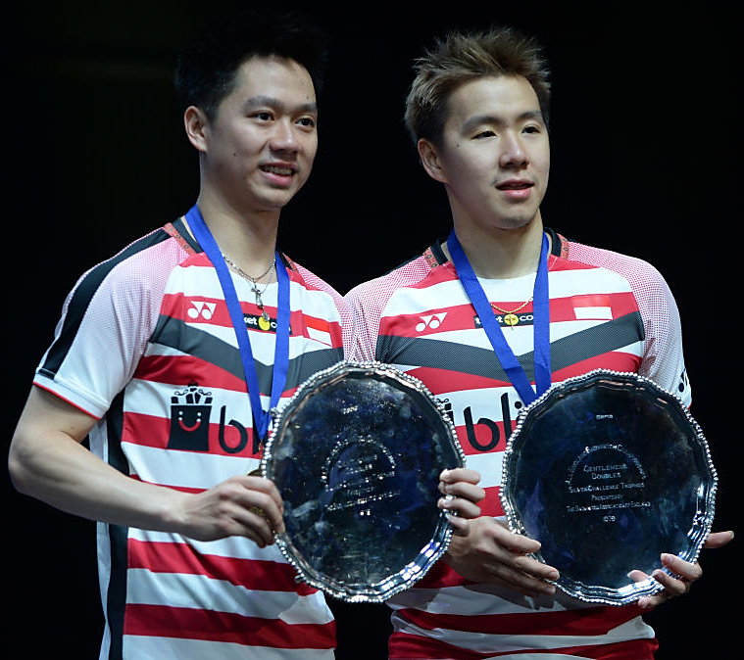


World #1
Men’s Doubles
Marcus Fernaldi GIDEON/Kevin Sanjaya SUKAMULJO
55
Rally Domination (%)
23
Fastest match (mins)
17
matches consecutively won
at most
72
Longest match (mins)
10-0
Best Head-to-Head
(bt. AHSAN/SETIAWAN)
3 Last Top Achievements
Indonesia Masters 2020
China Open 2019
French Open 2019
Calculations based only on matches from BWF World Tour ≥ S300 Level, starting from 2018 to All England 2020
Match Sources: bwfbadminton.com Rally Domination: total points won / total points, from all of matches
Fox Sport Asia

